Slide 1
Launching
Decentralized
Autonomous
Organizations
On Aragon

Slide 2
Table of Contents
Overview
Road to release
Understanding the problems
Project objective
Target audience
Introducing: Aragon Colonies
Evolutionary feedback loop of DAMits
Spotlight on Membership Dues Extension
Spotlight on Meetup Extension
Spotlight on Scholarship Extension
Spotlight on Working Group Extension

Slide 3
What is a DAO?
D
Decentralized - Anyone can participate from anywhere in the world
A
Autonomous - Without an intermediary
O
Organization - Self governance

Slide 4

The first DAO

Slide 5
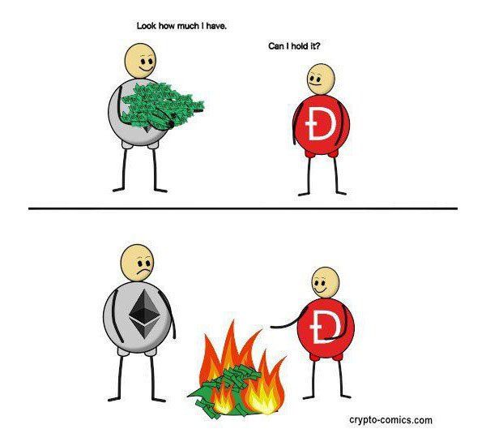
The DAO

Slide 6
What is Aragon?
aragonOS
aragonPM
aragonAPI
aragonUI
aragonCLI
Learn more at hack.aragon.org

Slide 7
What is Aragon?
Demo

Slide 8
Overview
We're approaching a zeitgeist opportunity in the Colorado Blockchain community to implement, experiment, and blaze the trail of utilizing a DAO framework. A DAMit especially lends itself to the Colorado Blockchain meetup culture and structure, and in turn could also potentially be applied globally to cultivate similar communities.
What is a Reputation Democracy?
A flat hierarchy, liquid democracy that facilitates its constituents’ ability to earn a consequential voice by associating one’s accrued reputation with their voting weight in organizational decision making processes.

Slide 9
Understanding the problems
D
Centralized hierarchical structures based on seniority instead of merit (with decisions being made behind closed doors by higher-ups) lack representation from the community and transparency in process.
A
Collaboration is messy, and measuring contributions over time in a peer-to-peer mental ledger is unsustainable. We need the right tooling to aggregate these metrics and automate the assessment.
O
Governance isn’t always fun, and it’s difficult to get members of a community to participate, especially in a consistent manner. We need to find the right incentive structures so that members are more aligned to contribute in consistently meaningful ways.

Slide 10
Project objective
Create an automated platform for incentivized collaboration by mode of gamified participation - enabling governance in an accessible, transparent, and entertaining fashion by utilizing bounties, reputation, and skills tracking - where participants neither need to know or trust one another to work towards the agreed upon objectives of an organization.

Slide 11



Target audience
While reputation democracies could be applied to virtually any organization, some examples include:
Co-ops
Labor unions
Gaming clans
Meetup groups
P2P insurance pools
Collaborative blogging platforms
And many more...

Slide 12
MeetUp Mark
Skills:
Persona 0
Mark is a Colorado Blockchain meetup organizer and attendee. He frequently hosts and attends meetups, but finds it difficult to lock down reliable volunteers to record his meetups and lacks the equipment and know-how to do it himself. He’ll also often post events in Slack.
75%
83%
17%
42%
Hosting
Attending
Volunteering
Outreach

Slide 13
Gamer Gabby
Skills:
Persona 1
Gabby focuses mostly on battling and occasionally goes on quests or raids with her clan, though she finds that the raids the leaders choose are often raids she’s not interested in. In these cases she’ll idly farm, earning materials for the clan.
19%
92%
43%
64%
Raids
PvP
Quests
Farming

Slide 14
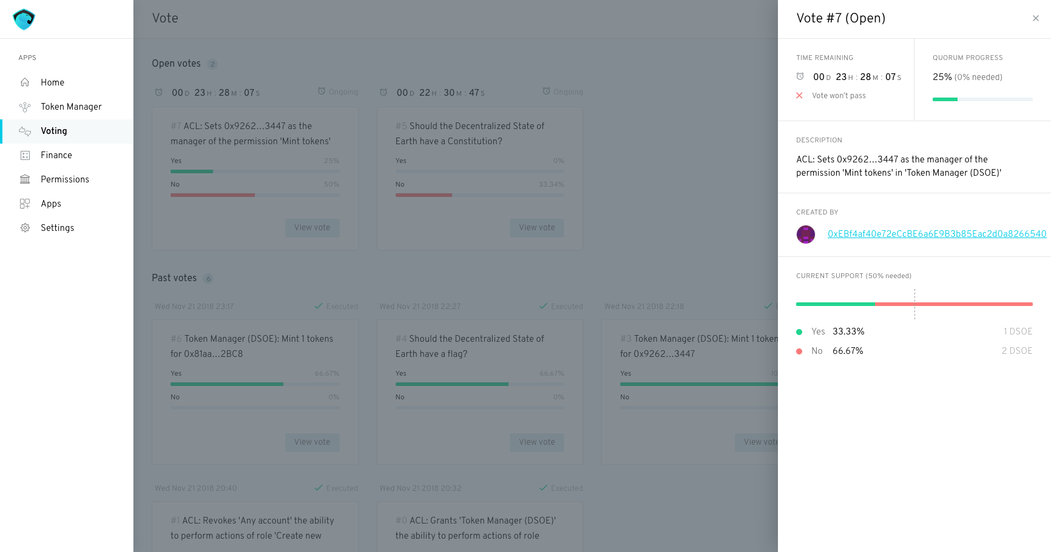
Introducing: Aragon Colonies
Bridging the gap between reputation and democracy
Once reputation is established, members of a DAMit can participate in the decision making processes of the community - with the amount of reputation accrued representing the weight of a member’s vote applied to a proposal. This is utilized to resolve issues such as:
Funds allocation
Future raid destinations
Charter direction
Buidlathon speaker selection TCR

Slide 15
Evolutionary feedback loop of a DAMit
04
Create Bounties
Upgrade
Tasks are assigned a monetary value and published for workers to accept
The community implements passing proposals. Lather, rinse, repeat
01
03
Work and
Participate
Propose and Vote
Members either fulfill tasks or collaborate online to earn money or reputation
Members use collected reputation to stake on proposals and vote on organizational decisions
02

Slide 16
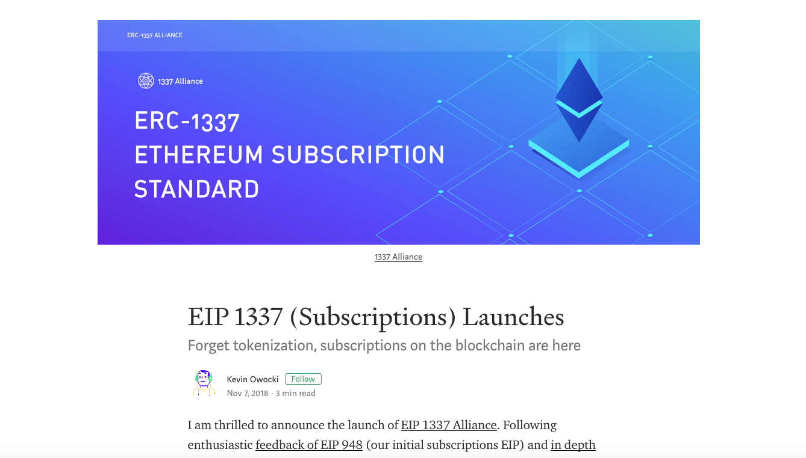
Spotlight on Membership Dues Extension
The crutch of financing for most* organizations
Requires members to pay a recurring EIP 1337 subscription for membership and voting capabilities to remain active

Slide 17
Road to release
JAN
FEB
MAR
APR
MAY
AUG
Kickoff
ETHDenver
3rd Party Integrations
Beta Release
Launch
Presentation
Aragon Colony app and extensions
Plugins for monitoring participation and automatically assigning reputation
Begin three month testing phase
Release to general public

Slide 18

Thank you!
Keep an eye out for @TheDenverDAO, coming soon to a device near you!
@proofoftom - Tommy Cox
github.com/DenverDAO
DenverDAO.org (Coming soon)

